Slide 1
Longest increasing subsequence
Data Structure and Algorithms II Laboratory
CSE 2218
Section: D
Course Instructor:
Akib Zaman
Lecturer, Dept. of CSE
United International University

Slide 2
About Us
Group: D2
Serial | Name | ID
1 | Abrar Asef | 011183005
2 | Shihab Md Akash Mondol | 011192046
3 | Amir Hamza | 011201019
4 | Hasibul Hasan Nirob | 011201031

Slide 3
Longest Increasing Subsequence
For instance:
Input: {10, 22, 9, 33, 21, 50, 41, 60}
Subsequences: {10}, {22},……….{10,9,33},………{10,22,33,50,60} etc.
Increasing subsequences: {10,22,33,50,60}, {33,50,60} etc.
Longest increasing subsequence => {10,22,33,50,60}
=> Length(LIS) => 5

Slide 4
Dynamic programming approach:
Iterator
Array | 10 | 22 | 9 | 33 | 21 | 50 | 41 | 60
LIS | 1 | 1 | 1 | 1 | 1 | 1 | 1 | 1

Slide 5
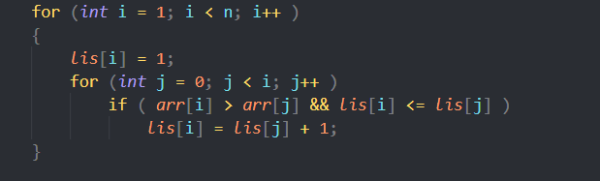
For i =1
Iterator | j | i
Array | 10 | 22 | 9 | 33 | 21 | 50 | 41 | 60
LIS | 1 | 1 | 1 | 1 | 1 | 1 | 1 | 1

Slide 6
For i =1
Iterator | j | i
Array | 10 | 22 | 9 | 33 | 21 | 50 | 41 | 60
LIS | 1 | 2 | 1 | 1 | 1 | 1 | 1 | 1

Slide 7
For i =2
Iterator | j |  | i
Array | 10 | 22 | 9 | 33 | 21 | 50 | 41 | 60
LIS | 1 | 2 | 1 | 1 | 1 | 1 | 1 | 1

Slide 8
For i =2
Iterator |  | j | i
Array | 10 | 22 | 9 | 33 | 21 | 50 | 41 | 60
LIS | 1 | 2 | 1 | 1 | 1 | 1 | 1 | 1

Slide 9
For i =3
Iterator | j |  |  | i
Array | 10 | 22 | 9 | 33 | 21 | 50 | 41 | 60
LIS | 1 | 2 | 1 | 1 | 1 | 1 | 1 | 1

Slide 10
For i =3
Iterator |  | j |  | i
Array | 10 | 22 | 9 | 33 | 21 | 50 | 41 | 60
LIS | 1 | 2 | 1 | 2 | 1 | 1 | 1 | 1

Slide 11
For i =3
Iterator |  |  | j | i
Array | 10 | 22 | 9 | 33 | 21 | 50 | 41 | 60
LIS | 1 | 2 | 1 | 3 | 1 | 1 | 1 | 1

Slide 12
For i =4
Iterator | j |  |  |  | i
Array | 10 | 22 | 9 | 33 | 21 | 50 | 41 | 60
LIS | 1 | 2 | 1 | 3 | 1 | 1 | 1 | 1

Slide 13
For i =4
Iterator |  | j |  |  | i
Array | 10 | 22 | 9 | 33 | 21 | 50 | 41 | 60
LIS | 1 | 2 | 1 | 3 | 2 | 1 | 1 | 1

Slide 14
For i =4
Iterator |  |  | j |  | i
Array | 10 | 22 | 9 | 33 | 21 | 50 | 41 | 60
LIS | 1 | 2 | 1 | 3 | 2 | 1 | 1 | 1

Slide 15
For i =4
Iterator |  |  |  | j | i
Array | 10 | 22 | 9 | 33 | 21 | 50 | 41 | 60
LIS | 1 | 2 | 1 | 3 | 2 | 1 | 1 | 1

Slide 16
For i =5
Iterator | j |  |  |  |  | i
Array | 10 | 22 | 9 | 33 | 21 | 50 | 41 | 60
LIS | 1 | 2 | 1 | 3 | 2 | 1 | 1 | 1

Slide 17
For i =5
Iterator |  | j |  |  |  | i
Array | 10 | 22 | 9 | 33 | 21 | 50 | 41 | 60
LIS | 1 | 2 | 1 | 3 | 2 | 2 | 1 | 1

Slide 18
For i =5
Iterator |  |  | j |  |  | i
Array | 10 | 22 | 9 | 33 | 21 | 50 | 41 | 60
LIS | 1 | 2 | 1 | 3 | 2 | 3 | 1 | 1

Slide 19
For i =5
Iterator |  |  |  | j |  | i
Array | 10 | 22 | 9 | 33 | 21 | 50 | 41 | 60
LIS | 1 | 2 | 1 | 3 | 2 | 3 | 1 | 1

Slide 20
For i =5
Iterator |  |  |  |  | j | i
Array | 10 | 22 | 9 | 33 | 21 | 50 | 41 | 60
LIS | 1 | 2 | 1 | 3 | 2 | 4 | 1 | 1

Slide 21
Final result:
Iterator |  |  |  |  |  |  | j | i
Array | 10 | 22 | 9 | 33 | 21 | 50 | 41 | 60
LIS | 1 | 2 | 1 | 3 | 2 | 4 | 4 | 5

Slide 22
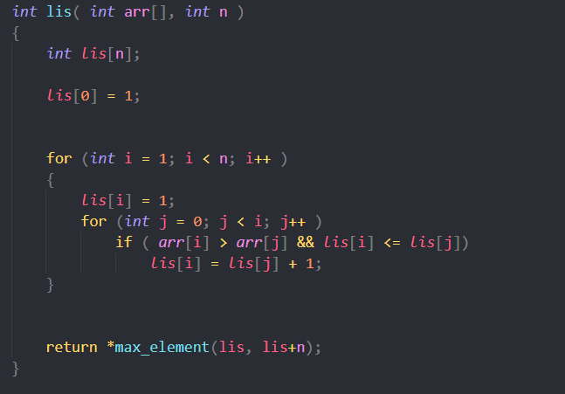

Slide 23
Thank you everyone for your patience

Slide 24

Any questions?

